Slide 1
DC Level of Stress
Jiahui
2016-12-9

Slide 2
Data
 |  | Not sure | If LTS==1: Length_Ft Else: 0 | If LTS==2: Length_Ft Else: 0 | If LTS==3: Length_Ft Else: 0 | If LTS==4: Length_Ft Else: 0 | Street :21831 Ramp: 361 hwyramp: 220 ServiceRoad: 132 | Not sure | Lines, can be transformed to lat, lon.
index | LTS | Length_Ft | LgthLTS1 | LgthLTS2 | LgthLTS3 | LgthLTS4 | RoadClass | Ward | geometry
0 | 2 | 128.682263 | 0.000000 | 128.682263 | 0.000000 | 0.000000 | Street | 7 | LINESTRING Z (1321779.247861594 438938.9514425...
1 | 4 | 499.465203 | 0.000000 | 0.000000 | 0.000000 | 499.465203 | Street | 3 | LINESTRING Z (1288708.208360761 464193.3891225...
2 | 2 | 245.518115 | 0.000000 | 245.518115 | 0.000000 | 0.000000 | Street | 6 | LINESTRING Z (1314864.189513251 449643.6544425...
3 | 4 | 32.747790 | 0.000000 | 0.000000 | 0.000000 | 32.747790 | Street | 3 | LINESTRING Z (1287081.259514928 452847.7261183...
4 | 4 | 115.547099 | 0.000000 | 0.000000 | 0.000000 | 115.547099 | Street | 2 | LINESTRING Z (1299239.322469086 454296.0171850...

Slide 3
LTS distribution

Slide 4
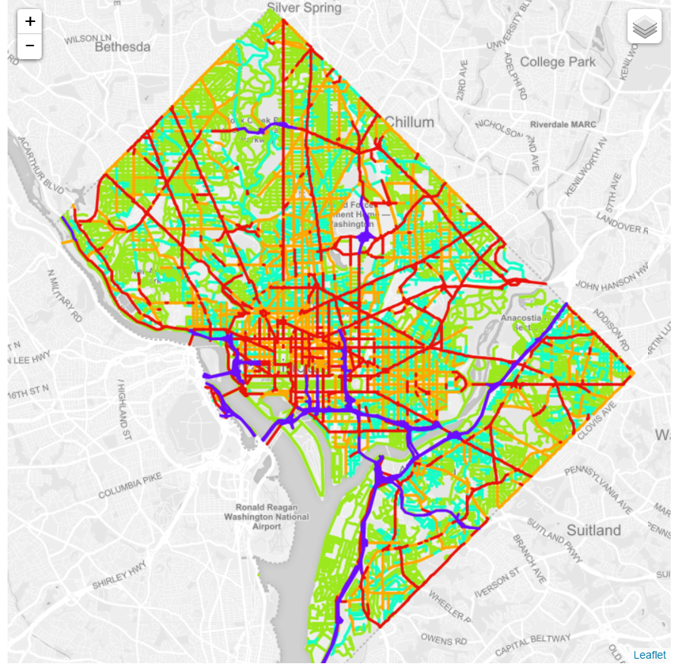
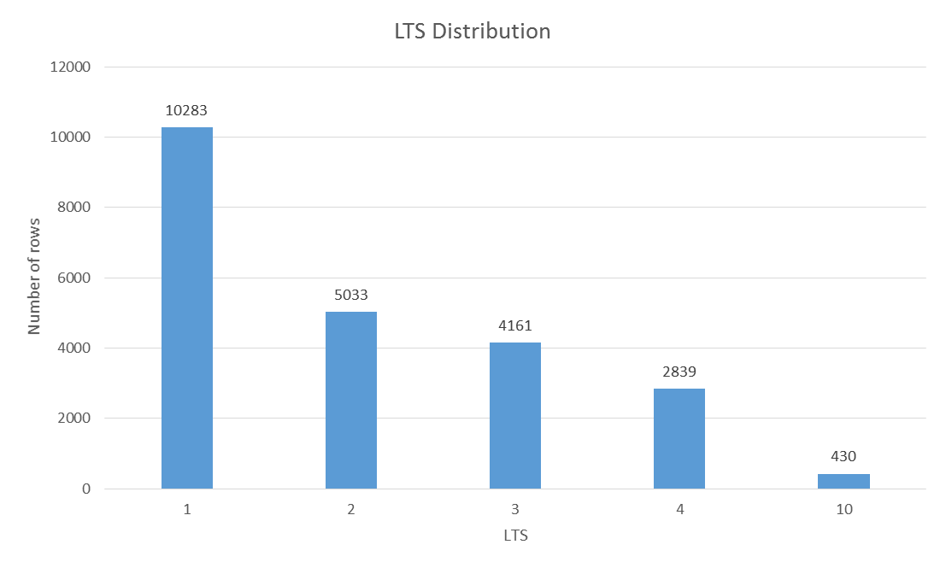
LTS on the map
LTS = 1
LTS = 2
LTS = 3
LTS = 4
LTS = 10
Meaning
unknown
Interactive map is on Drive. Download .html and .js into the same folder, open the .html file

Slide 5
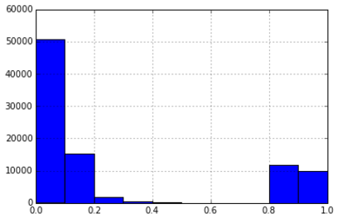
Match with DC segments
Buffer both DC segments and LTS lines with 10 meters
Calculate the overlap area percentage:
Area(overlap)/Area(smaller buffered Line) * 100%
Overlap percentage>0.8 is considered as the same segments
Histogram of overlap percentage

Slide 6
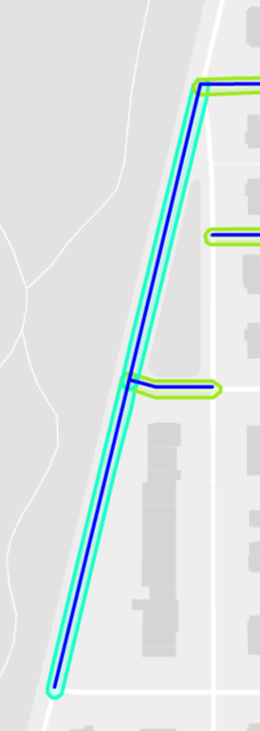
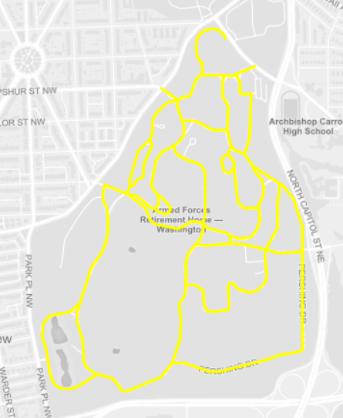
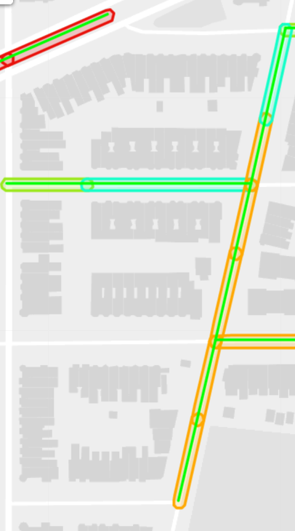
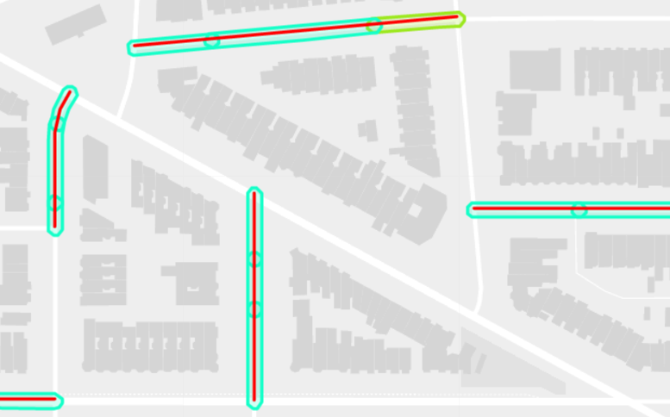
Match with DC segments
For 13522 dc segments
7649 match 1 LTS line
3772 match 2 LTS lines
1932 match >=3 LTS lines
169 match no LTS lines (0.0125%)
Match 1 example
Line is DC seg
Underlying polygon is LTS line, color corresponding to previous map
No match example
Match >=3 example
One segment with multiple match could have different LTS, but based on my observation, mostly have the same LTS.
Match 2 example

